Slide 1

Flutter

Slide 2
Google Map

Slide 3
Dependencies
google_maps_flutter:
geolocator:
geocoding:

Slide 4
Configurations
android/app/src/main/AndroidManifest.xml:
<meta-data
android:name="com.google.android.geo.API_KEY"
android:value="YOUR_GOOGLE_MAPS_API_KEY"/>
<uses-permission android:name="android.permission.ACCESS_FINE_LOCATION"/>
<uses-permission android:name="android.permission.ACCESS_COARSE_LOCATION"/>

Slide 5
Google Map Widget
CameraPosition( target: zoom: 15,),
// here target requires LatLng object
GoogleMap(
initialCameraPosition:
markers:
onTap:
onMapCreated:
)
Marker(
markerId: const MarkerId("selected_location"),
position: tappedPoint,
infoWindow: const InfoWindow(title: "Selected Location"),
),
void _onMapTapped(LatLng tappedPoint) { }
(controller) {
_mapController = controller;
},
GoogleMapController? _mapController;

Slide 6
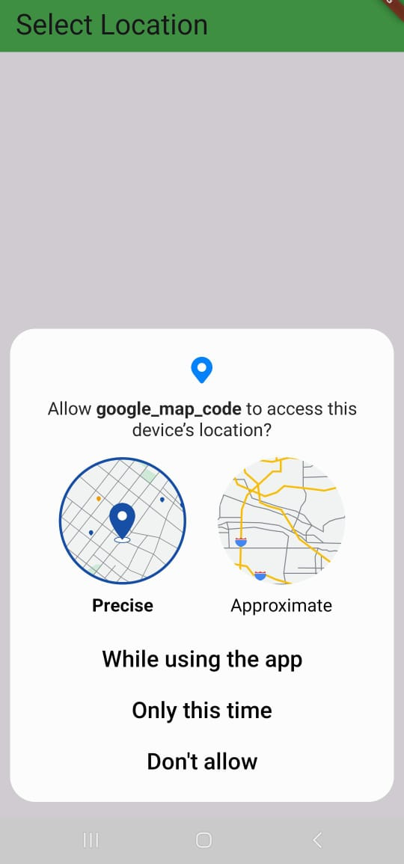
Current Location
Future<void> _getCurrentLocation() async {
bool serviceEnabled = await Geolocator.isLocationServiceEnabled();
if (!serviceEnabled) return;
LocationPermission permission = await Geolocator.checkPermission();
if (permission == LocationPermission.denied) {
permission = await Geolocator.requestPermission();
}
Position position = await Geolocator.getCurrentPosition(
desiredAccuracy: LocationAccuracy.high);
_currentLocation = LatLng(position.latitude, position.longitude);
}

Slide 7
Location Name form Lat and Lng
Future<void> getAddressFromLatLng(double lat, double lng) async {
List<Placemark> placemarks = await placemarkFromCoordinates(lat, lng);
Placemark place = placemarks.first;
locationName= "${place.name},: ${place.locality},: ${place.administrativeArea}, ${place.country}";
setState(() {
});
}

Slide 8
Thank You

